Slide 1
Java Programming
Write once, run anywhere

Slide 2
Content of the Day
Module3: Java Advanced | 0- Recap of Java Basics 1- Recap on Object-Oriented Programming (OOP) Concepts 2- Strings 3- Exceptions 4- Generics

Slide 3
3.0
OOP Revision
All what u need to know

Slide 4
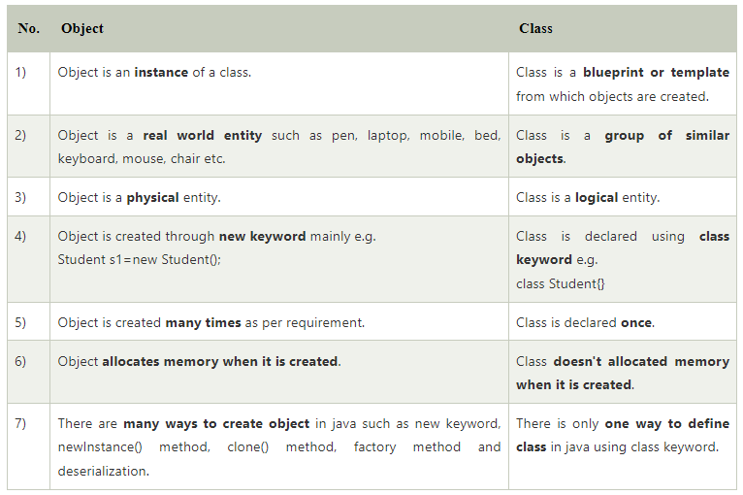
Exception
Notes:
Class vs object

Slide 5
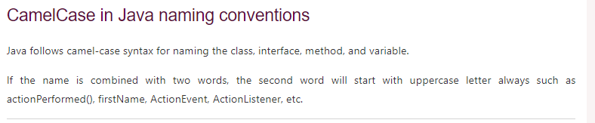
camel case
Notes:
Camel case

Slide 6
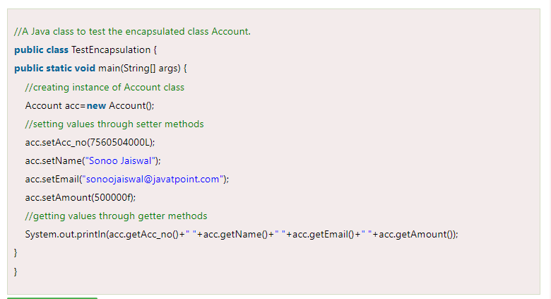
Exception
Notes:
Encapsulation

Slide 7
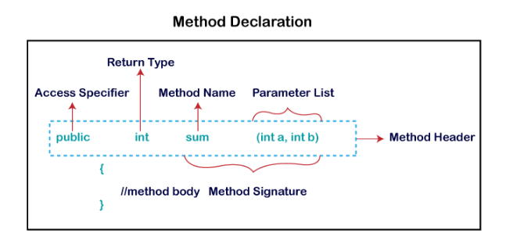
Method Declaration
Notes:
Access Modifier : public – private – default
Return type : void – int – string – double - …

Slide 8
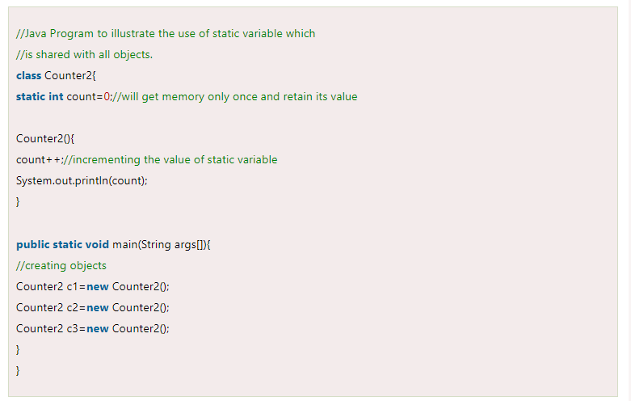
Exception
Notes:
Static

Slide 9
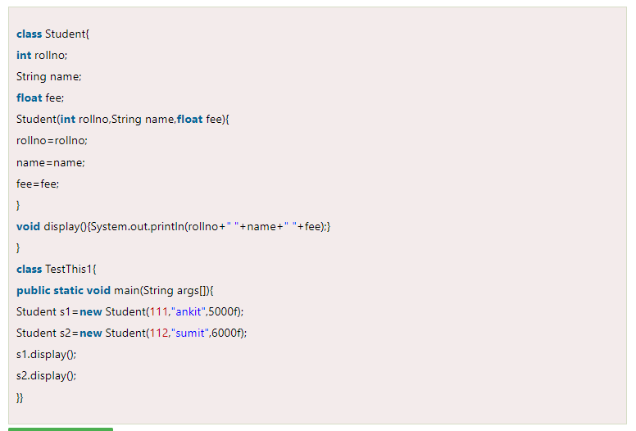
Exception
Notes:
0 Null 0
0 Null 0

Slide 10
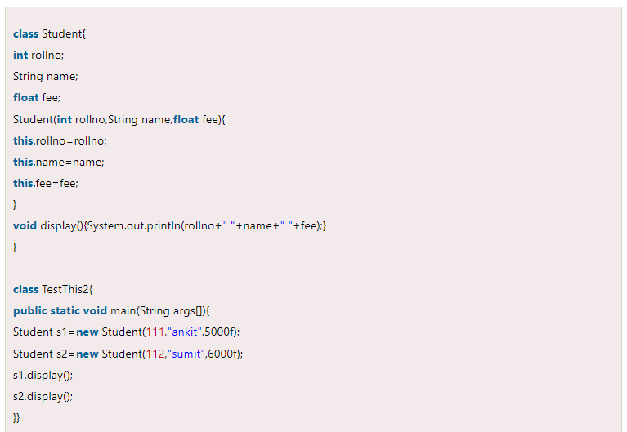
Exception
Notes:
Ankit 5000
sumit 6000

Slide 11
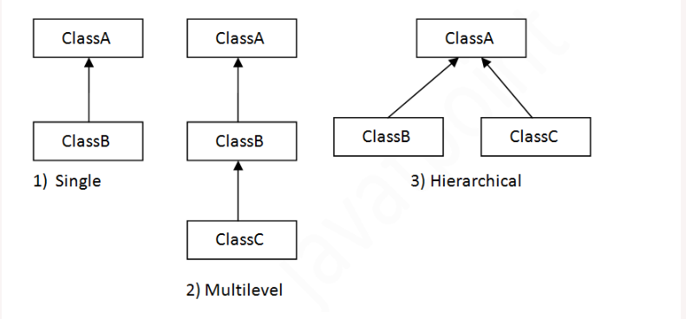
Notes:
Inheritance types in java

Slide 12
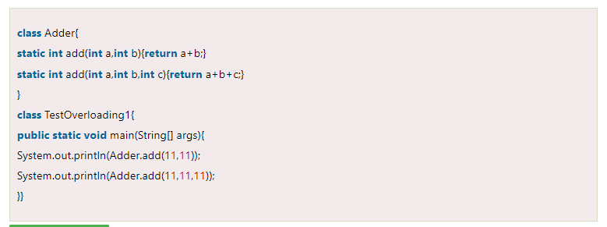
Overloading
Notes:
See difference in parameters

Slide 13
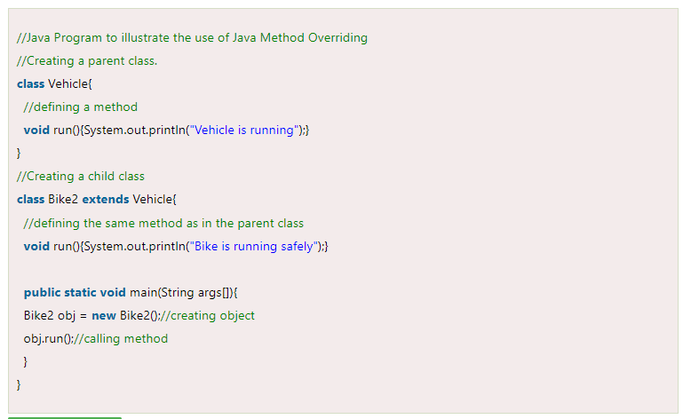
Overriding
Notes:
overriding

Slide 14
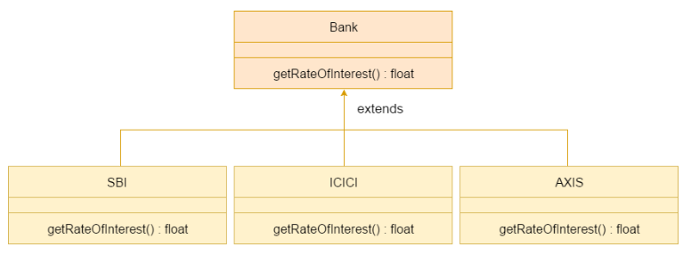
Notes:
Overriding in high level

Slide 15
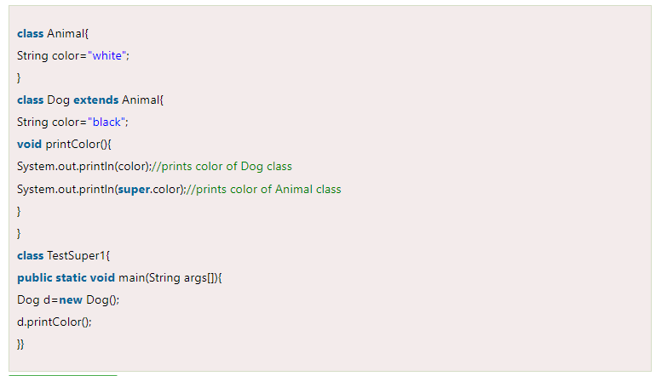
Super keyword
Notes:
Super

Slide 16
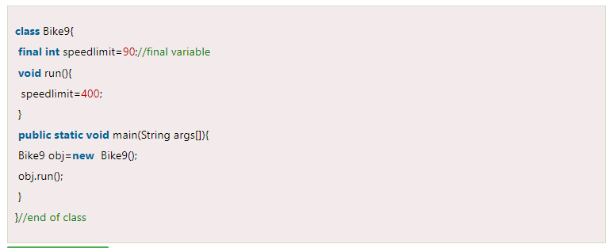
Final variable
Notes:
Final variable

Slide 17
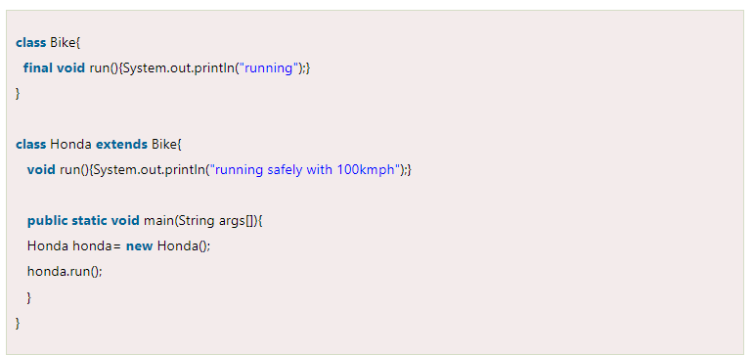
Final Method
Notes:
Final Method

Slide 18
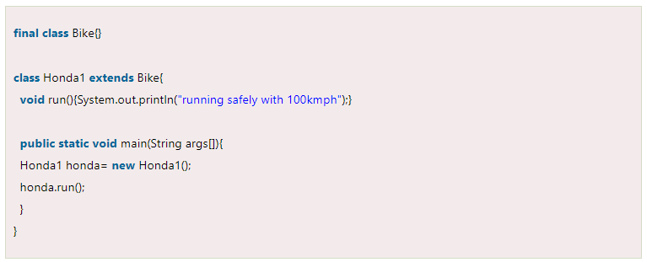
Final class
Notes:
Final class

Slide 19
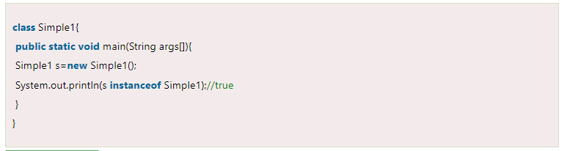
Instance of

Slide 20
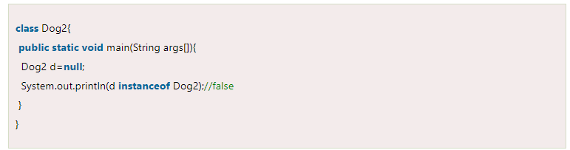
Instance of

Slide 21
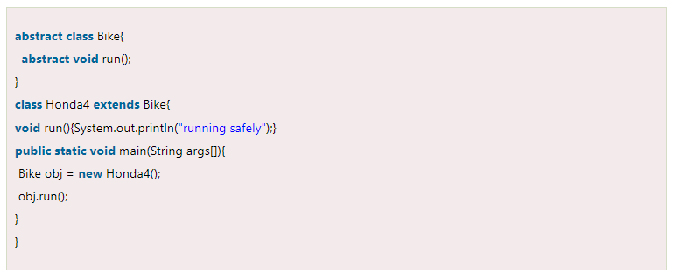
Abstract

Slide 22
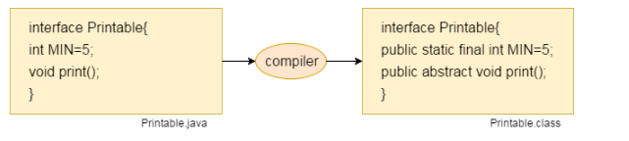
interface

Slide 23
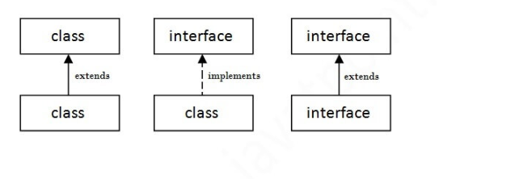
Extends / implements

Slide 24
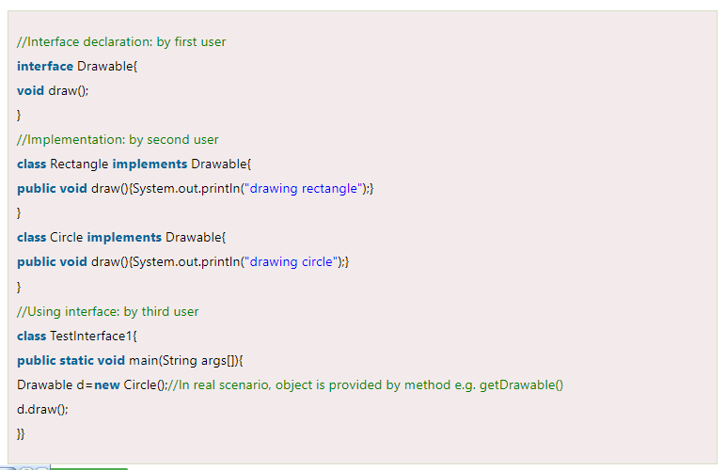
Exception

Slide 25
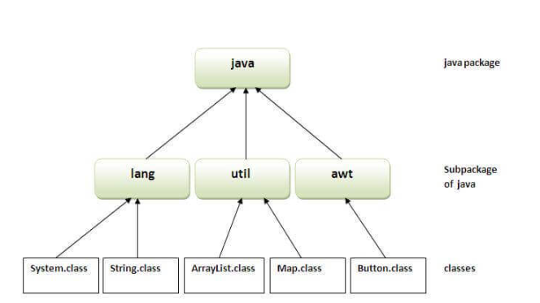
Packages

Slide 26
Thanks!
Do you have any questions?
amerosama.jr@gmail.com
01007698027

